Slide 1
AI DEVICE FEVER SCREENING

Slide 2
CONTENT
Abstract
Problem Statement
Literature Survey
Proposed system
System Design
Implementation
Results
Conclusion
Reference

Slide 3
ABSTRACT
Coronavirus disease (covid-19) is a global pandemic, and every country is actively fighting against the virus.
It is an effective way to prevent the spread of the virus in finding the person with abnormal temperature promptly in order to perform further medical observation.
However, the traditional method of temperature measurement has low efficiency and accuracy.

Slide 4
PROBLEM DEFINITION
Covid-19 is the major pandemic, we are facing these days, Finding the person with abnormal temperature plays a major role in maintaining safety and to avoid the spread of covid.
So, to overcome this issue we need a solution to find the body temperature of a person, Increasing accuracy up to 75 % to 80 %.

Slide 5
LITERTURE SURVEY
Title of paper | Authors | Method | Advantages | Disadvantages
Image processing Based Body temperature estimation using thermal video sequence (IEEE-2019) | Arpita Sharma | Jones Algorithm, Infrared Camera | High and Speed performance | Turned faces are not detected , less accuracy(10⁰ C- 35⁰ C)
Thermal Image DataSet For Person Detection (IEEE- 2020) | Marina Ivasic-Kos | Longwave Infrared (LWIR) camera | Best performance | less contraction of light
Regularization of body core temperature prediction during physical activity (Research Gate - 2019) | Thomas Mckenna, Andrei Gribok | Semantic Segmentation (Clustering), Spinnaker | Fast and accurate Detection | Person is need for checking the temperature

Slide 6
PROPOSED SYSTEM
In our approach we try to build a model which takes input from the live camera and detect the face and screen the body temperature using sensor.
The accuracy to which The body temperature is predicted mainly depends on the sensor and the below packages.
In this system we used packages are:
pi camera ,mlx90614 sensor

Slide 7
MLX90614 sensor :
Operating Voltage: 3.6V to 5V (available in 3V and 5V version)
Supply Current: 1.5mA
Object Temperature Range: -70° C to 382.2°C
Ambient Temperature Range: -40° C to 125°C
Accuracy: 0.02°C
Field of View: 80°
Distance between object and sensor: 2cm-5cm
pi camera :
5MP colour camera module , Light weight and portable, Resolution: 2592 * 1944

Slide 8
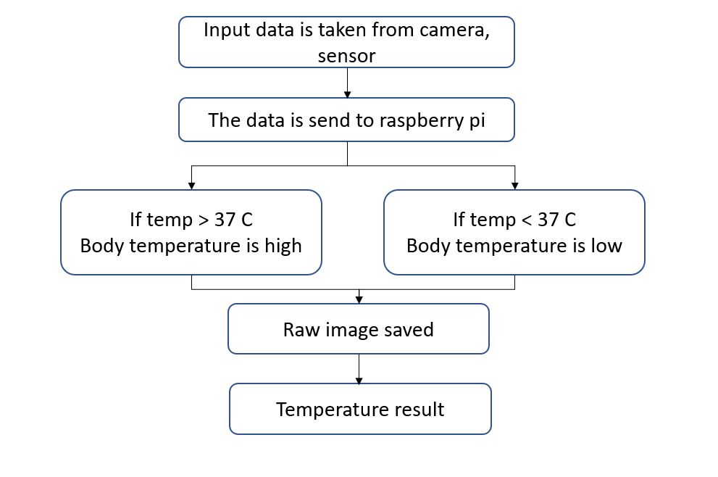
SYSTEM DESIGN

Slide 9
Implementation:
We have built a model that detects body temperature is measured using the contactless temperature sensor and displayed in monitor.
If the person is body temperature value is less than 37 C then it is normal.
If body temperature value is great than 37 C then it capture image and store in file with date and time

Slide 10
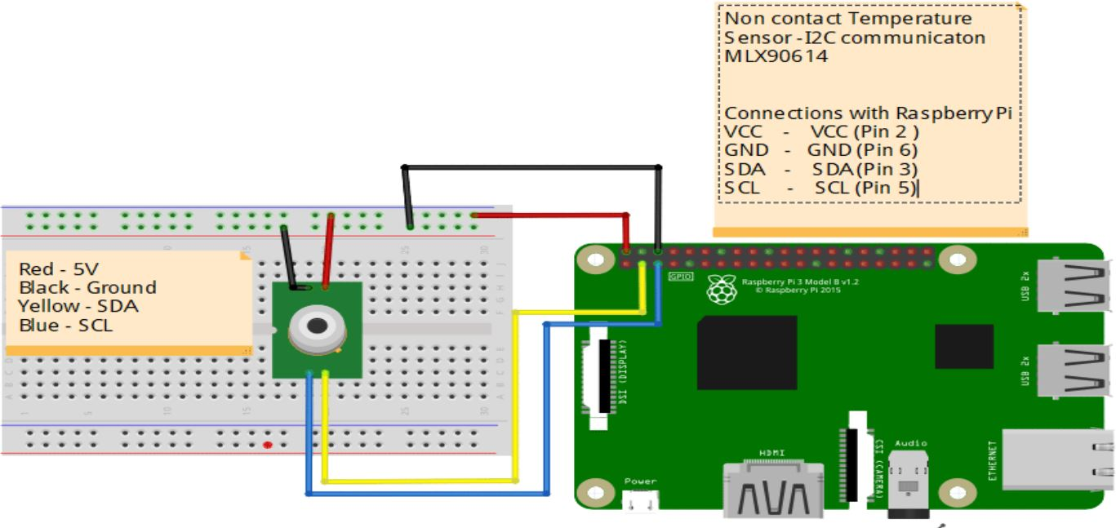
SIMULATION SCREENSHOT

Slide 11
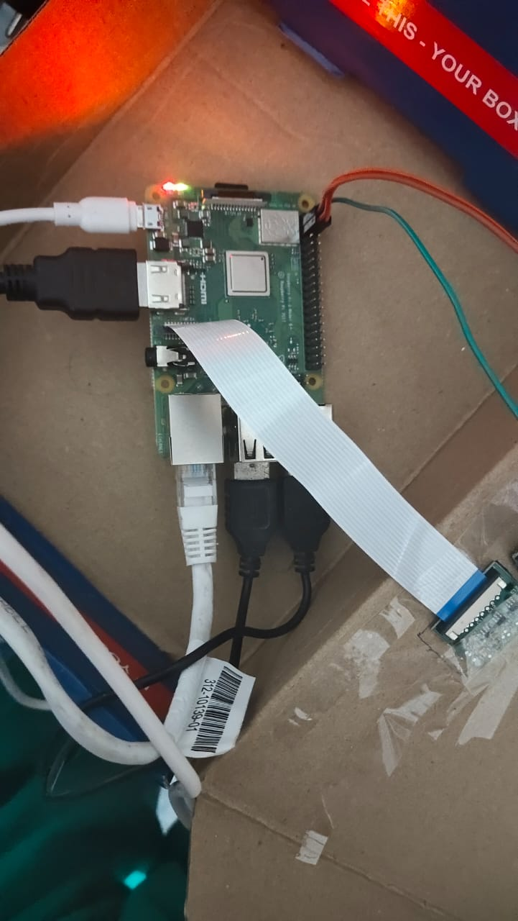
Hardware implementations

Slide 12
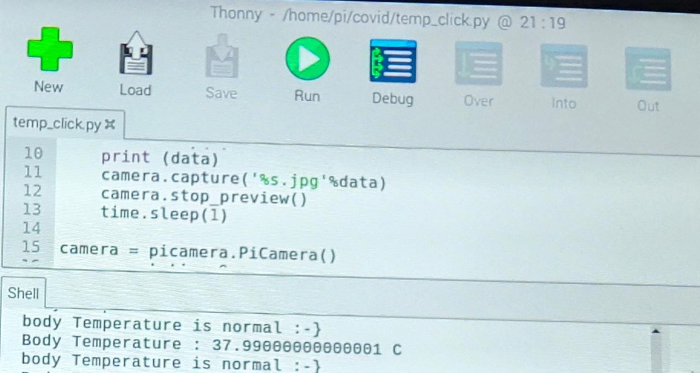
Result

Slide 13
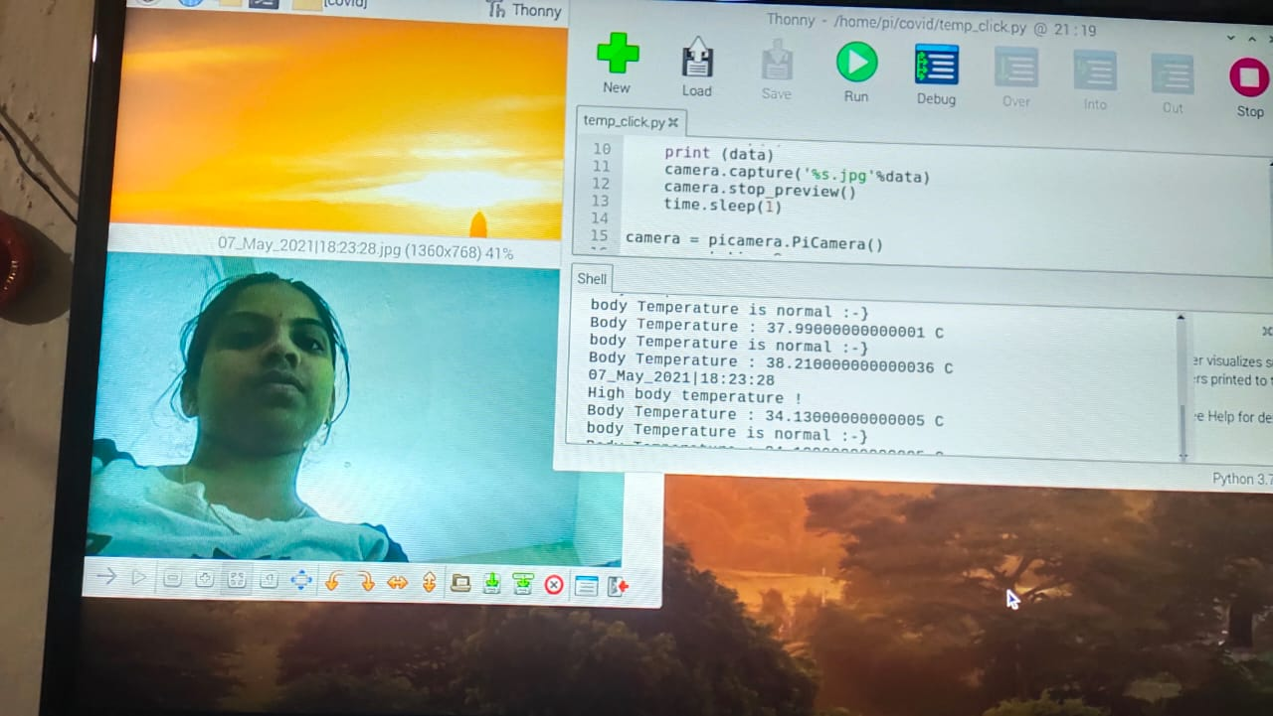

Slide 14
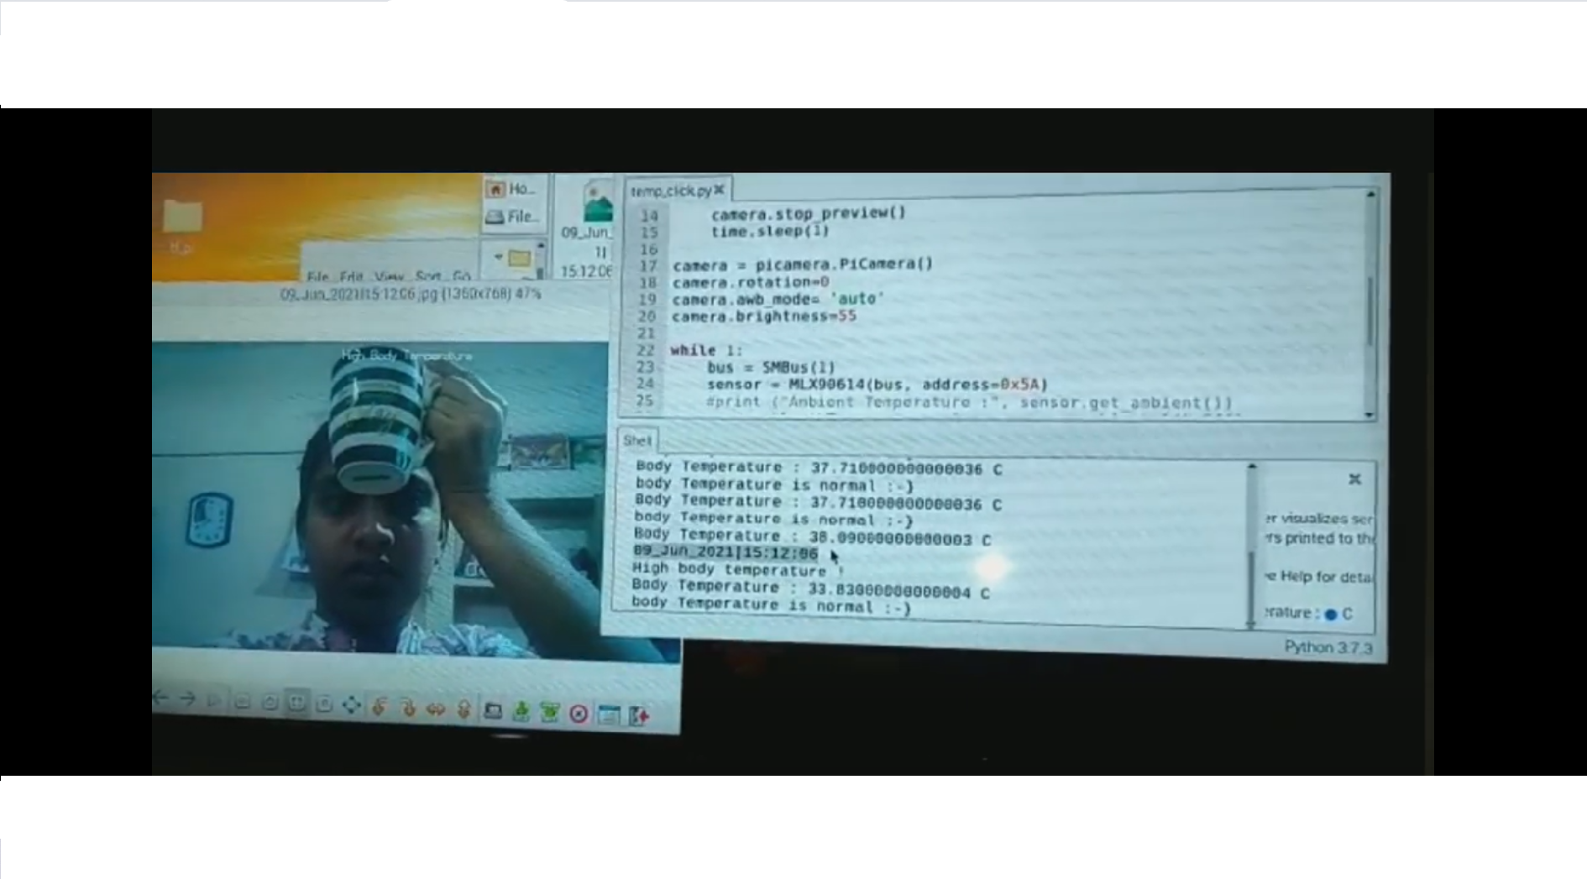

Slide 15
CONCLUSION
Fever Screening can be used in real time applications which are meant for safety in this covid pandemic time.
The accuracy to which the screening works depends on the sensor and methods used to screen the temperature.

Slide 16
REFERENCES
_{[1]} Image processing Based Body temperature estimation using thermal video sequence, IEEE-2019,Arpita Sharma.
_{[2]} Prediction of human core body temperature using Invasive measurement Methods Research Gate - 2019, Simon Annaheim.
_{[3]} Regularization of body core temperature prediction during physical activity Research Gate - 2019,Thomas Mckenna, Andrei Gribok.
_{[4]}Thermal Imaging Dataset for Person Detection, Research gate, IEEE-2020, Marina Ivasic-Kos.

Slide 17
ANY QUERIES ?

Slide 18
☺ THANK YOU ☺

